Slide 1
HRe3 Radar Data Extraction
Ingolstadt,10.11.2020

Slide 2
EDAG Manual Summarize: Goal
Achieve the autocalibration 100% progress in Master and Slave as quick as possible, considering the autocalibration does not work in low speeds and curves, in this way the sensor must quick calibrate. For this reason on highway it is the scnario where it calibrates faster.
Measure and compare this calibration in different scnearios: Highways, dirt road, city, with respect to Time (H:M:S) and Distance (km)
Perform trip-tests and get the traces using different cars and colors for the bumpers.
Obs: Numerous trips were done with 4 different cars (71tests + 99 tests), they tried a 3 lanes highway with about 250 meters free for high speed with the car centered in the middle lane. The result was achieving about 22% (max) of calibration for the master and 38% (max) for the slave. This mean that more than 5 km was required to finish the calibration for master and 3 km for the slave (on highway), in city much more because of curves…
Was also concluded that the GOA variation rate does not have any relation with the progress rate calibration.

Slide 3
Previous Tests Conclusions
There are some features where data (events) are not collected: In the city where there are 2 lanes for drivers, urban perimeter, curves.
A weak-normal rain does not affect the calibration.
The slave is calibrated before the master (250 meter-test)
The calibration occur before in the highway, later in the dirt road and last in the city, because of speed and lot of curves…
Just 3 samples from 10 traces presented GOA over 2 degrees.
The slave tracks the left side of the lane and the master the right side. The slave calibrates first …Honestly I do not know why the slave gets calibrated faster?
After 5200 Events the calibration is achieved (100%) and the GOA (Global Offset Angle) is about (0.3˚) and remain constant until the last event (65000)
Example of conclusion I can use…
Master calibrates after 7 min or 4.8 km.
The master-angle fluctuates between 0 – 2 degrees during calibration
The graphic of page 14 manual would be better with different colors in scatter plot for different scenarios…

Slide 4
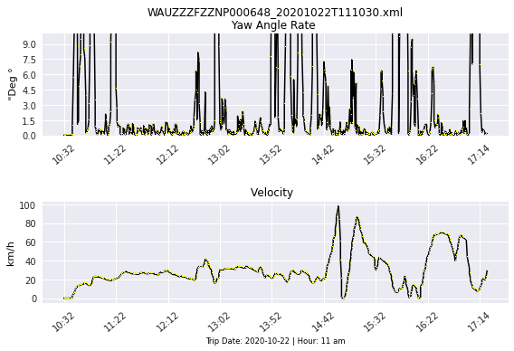
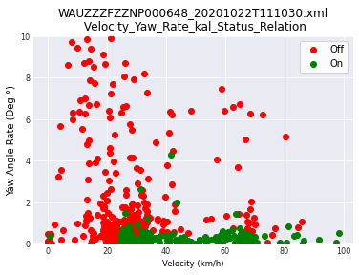
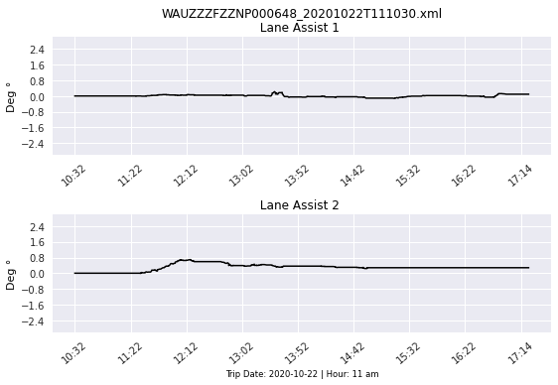
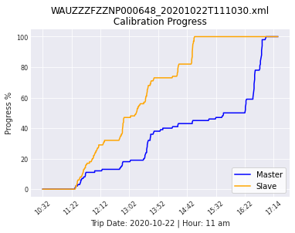
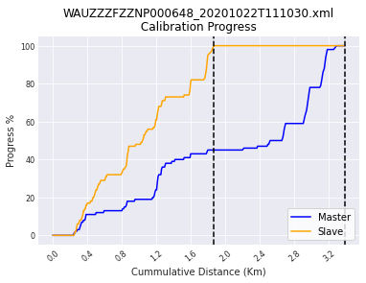

Slide 5
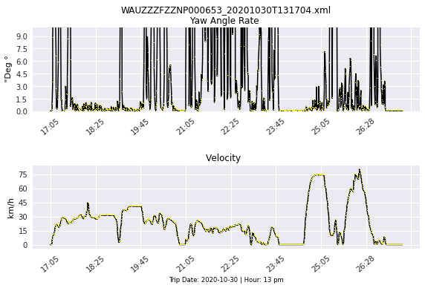
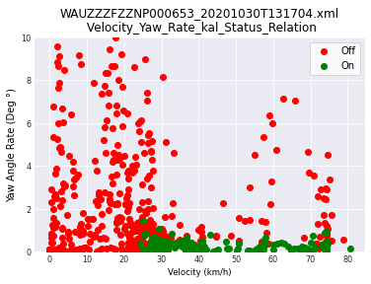
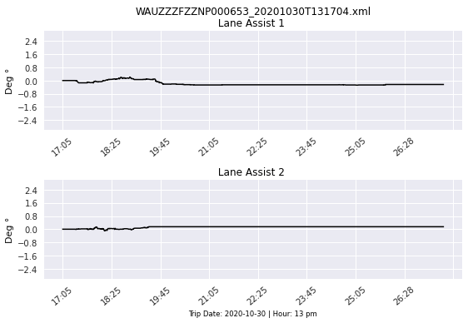
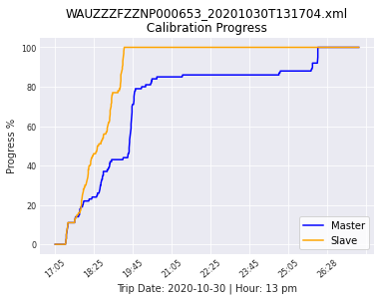
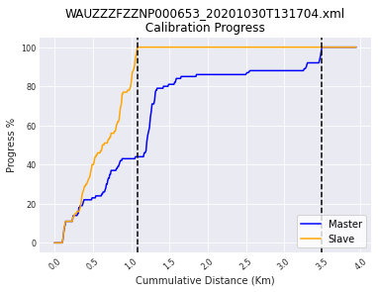

Slide 6
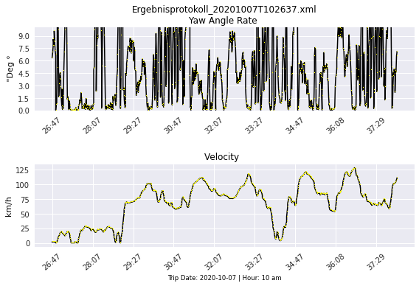
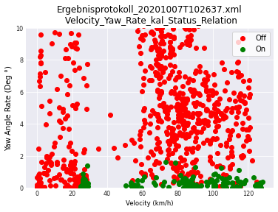
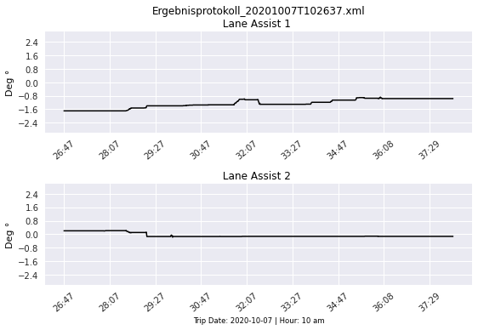
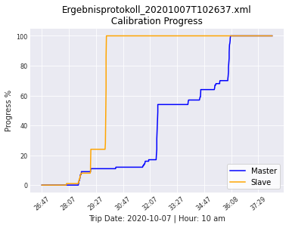
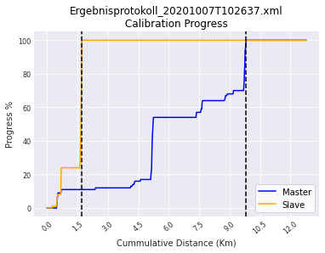

Slide 7
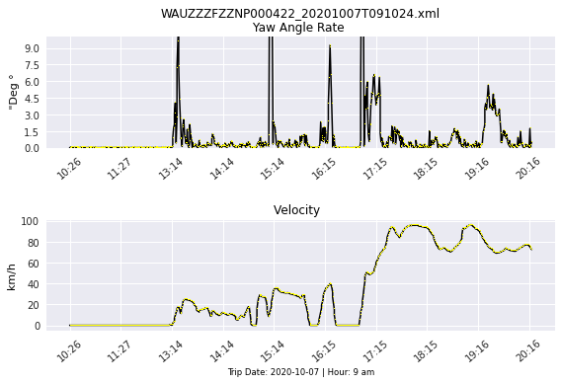
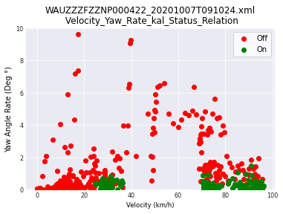
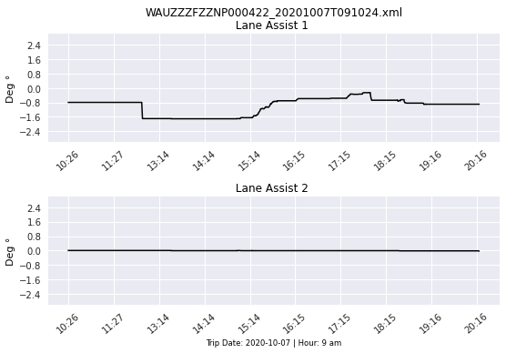
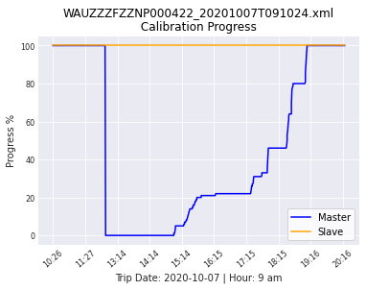
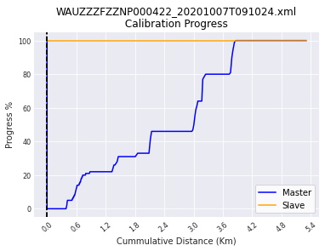

Slide 8
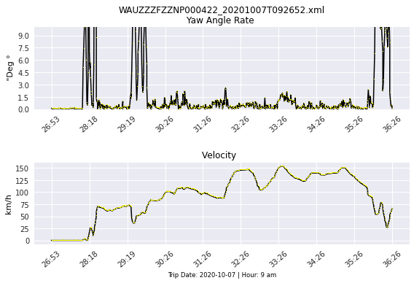
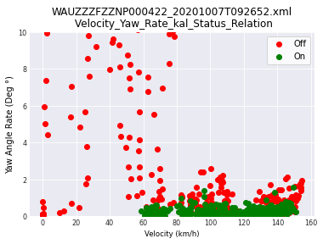
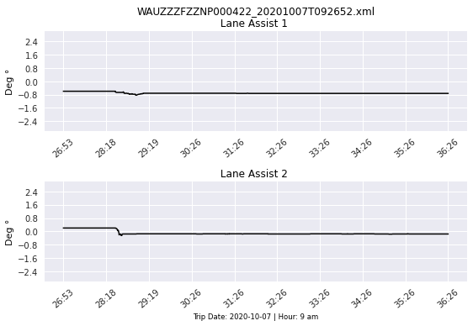
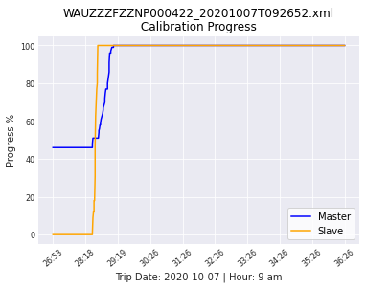
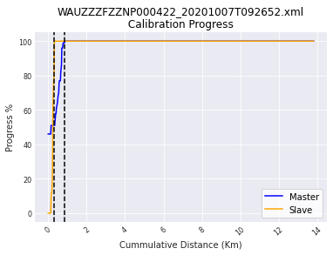

Slide 9
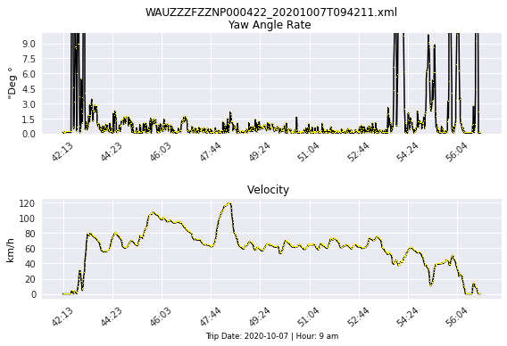
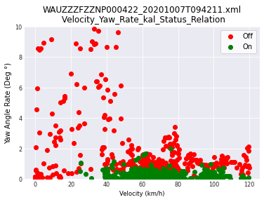
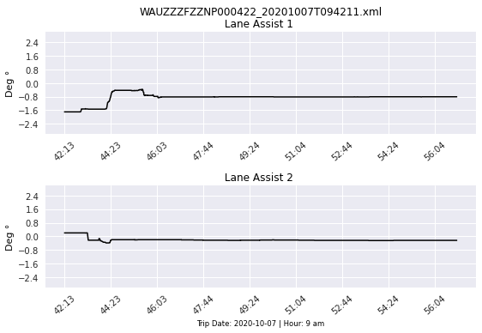
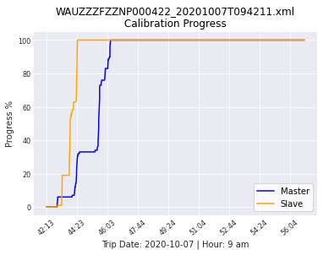
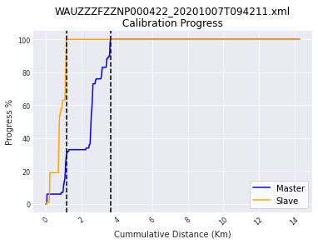

Slide 10
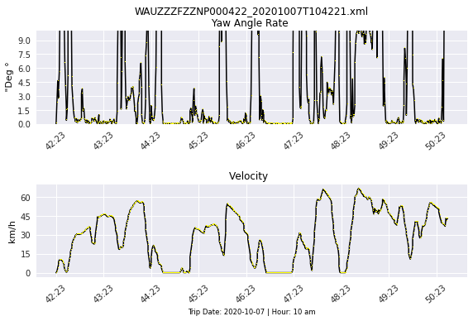
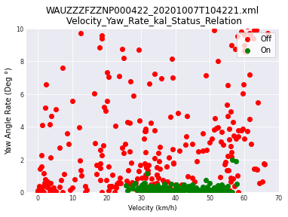
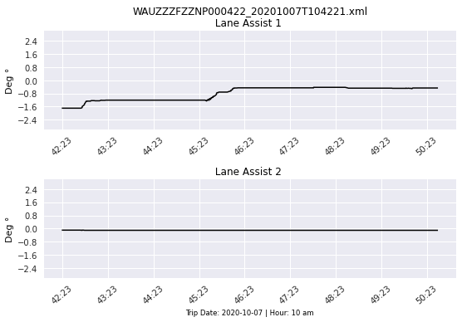
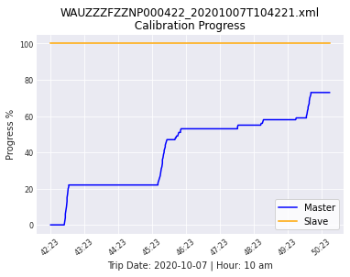
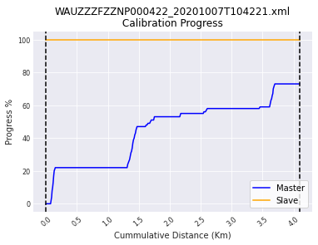

Slide 11
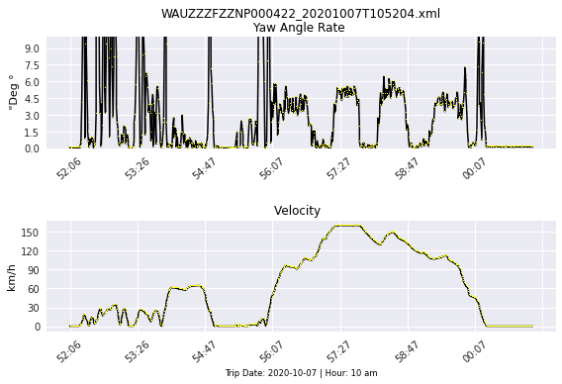
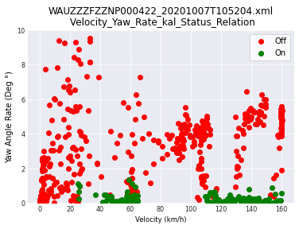
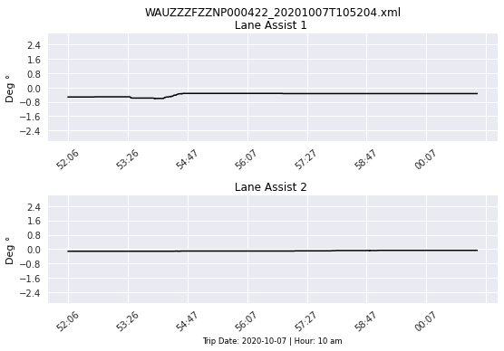
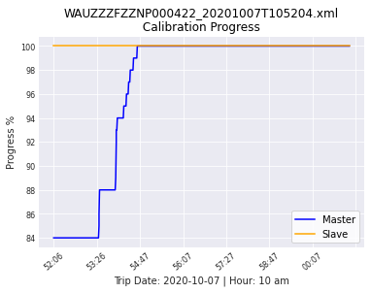
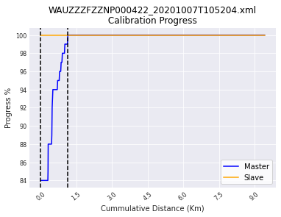

Slide 12
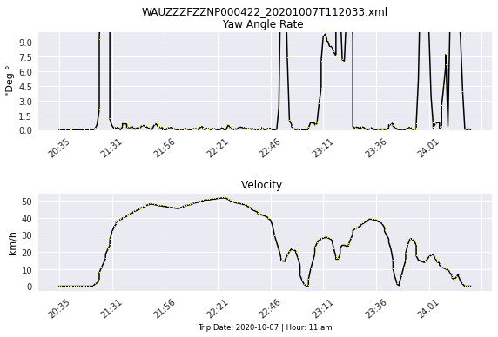
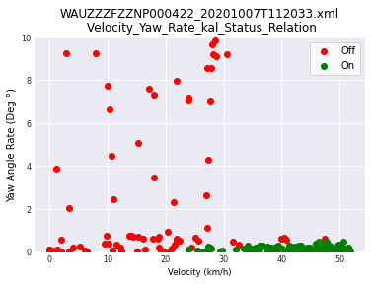
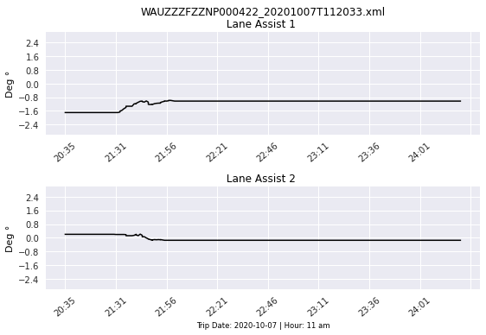
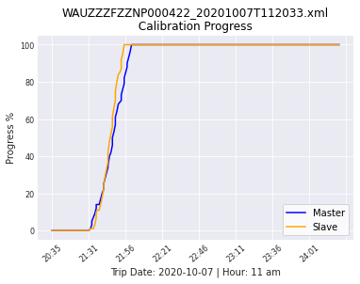
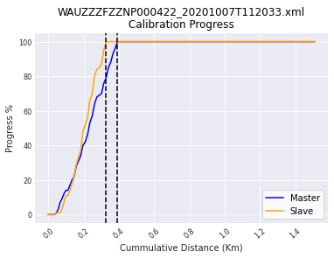

Slide 13
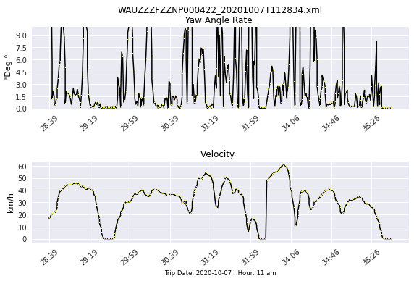
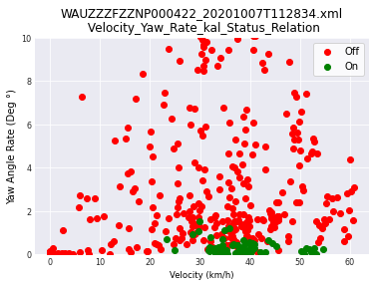
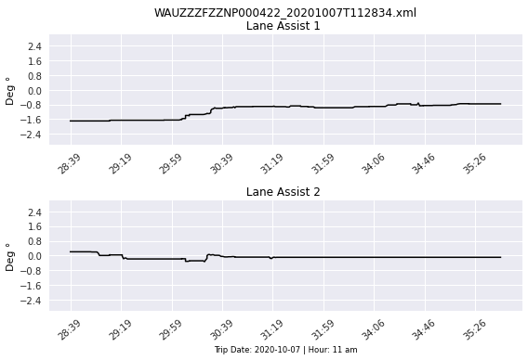
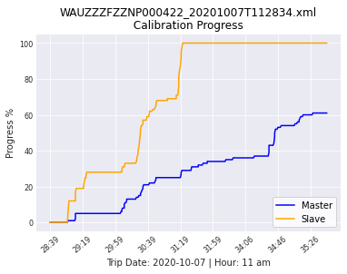
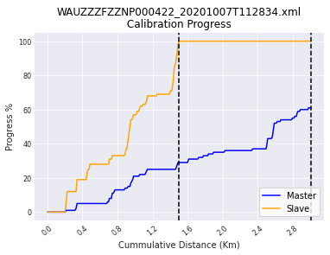

Slide 14






Slide 15






Slide 16






Slide 17






Slide 18
Partial Conclusions
In average the slave achieves 100% of calibration after travel 1 km-2 km . The master achieves the same amount after 3.5 km.
9.81 km was the longest traveled distance value for the master achieve 100% calibration. The median in master is about 4 km to be 100% calibrated. The median for the slave is about 1.7 km (done by head- not using calculator).
The slave is usually calibrated after the car travels half of the distance required to the master 100% calibration.
Some traces has a unusual behaviour such as begin within the master or/and slave calibration value with 100%, instead to begin with 0%. Besides that for some traces, the master started the calibration with more than 0% (46%, 35%,84%) for example, did not achieve 100% of calibration at the end of the trip, but less such as 61% and 73%. For all these unusual traces it was added a red star to highlight this behaviour.
It is possible to conclude through the scatter plot builted based on calibration status, that when the car velocity is over 25 km/h the calibration status switches from off (0) to on (1) and then the yaw angle rate variation decreases instantaneously and is rarely overcomes a variation of 1˚. When the speed in under 25 km/h the calibration status changes turns to off and the yaw rate variation increases again to rates over 10˚ until 70˚ per second, which means that the radar is probably turning in these low velocities, therefore this variation.

Slide 19
Old Conslusions backup
In the first 5 minutes of the trip (26 min – 31 min) the car has a speed under 100 Km/h. During this time the Lane Assist Assistance System works more significatively to change the car yaw orientation, to keep it in the center of highroad lanes.
When the car is in high speed the Dynamic Calibration is triggered and then there is a variation in sensor mounting angle about 6-7˚ (8|8.5 – 2.5|2) .
Different from the trip the yaw rate was bigger in higher speed, about 4 degrees increased (6-2)
The lane assist had the same behaviour to remain constant in high speeds, around 0. And variates in low speed until 0.8 degrees max, while for the trip the value achieved -1.6 degrees max.
Comparing the data of the trip and this one extracted in lab, it is possible to infer that the gap progress calibration over time is more narrow than the plots provided by the trip.
Average calibration Delta Time
Slave: 3,65 min
Master: 8,5 min

